Slide 1
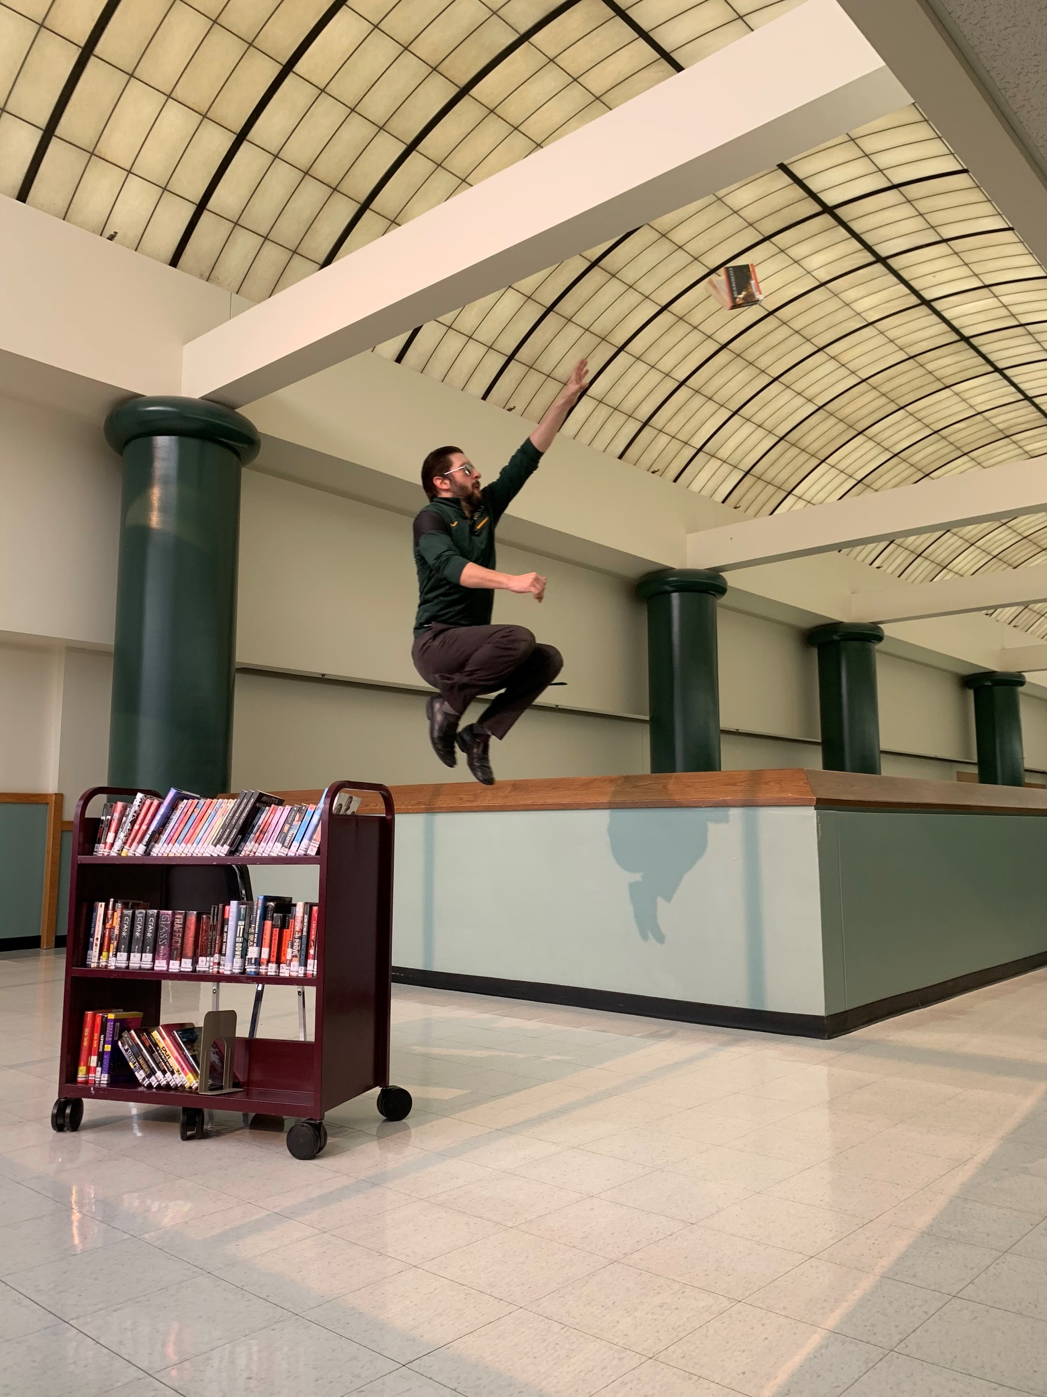
JUMP into a
good book this summer!
Check out the
English Department webpage on wvhs.ipsd.org
for
Teacher Recommendations!

