Slide 1
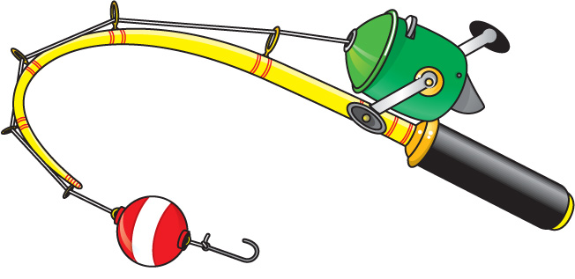
FISHING CLUB
Can we ‘Reel’ you in?
We are hosting an informational meeting soon!
DATE: Thursday, Sept. 12th
TIME: 2:30pm – 3:15pm
LOCATION: Room #192
Come make
new friends!
Have fun!
* Fishing Club participants must have a fishing license.
Any questions or inquiries, please contact Mr. Zawlocki.

