Slide 1
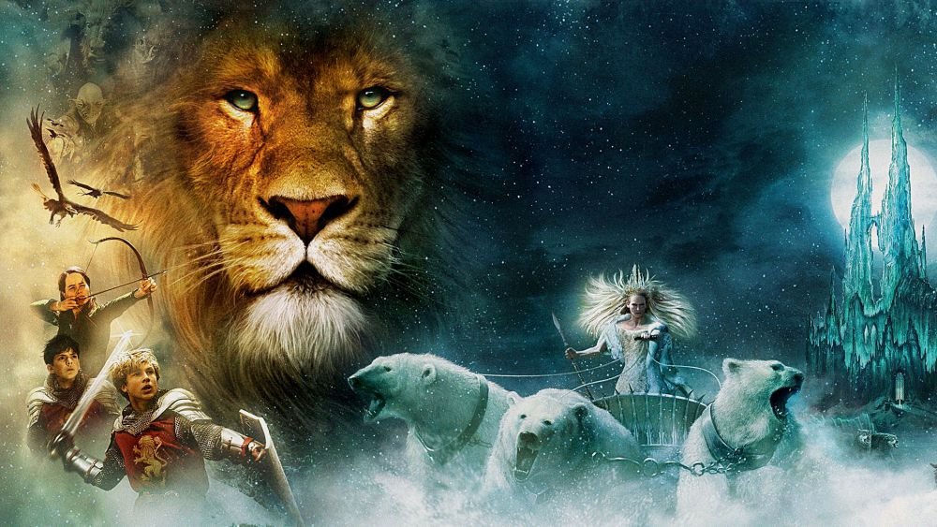
The Chronicles of Narnia
The Lion, the Witch
and the Wardrobe
An allegorical study on the fall and redemption of man
November 7th and 14th
2:35 – 3-45PM
Room 272

