Slide 1
Brooks Elementary
Academically Talented
Parent Information Night
September 19, 2017
Notes:
Terri

Slide 2
Mission of District 204
“Inspire all students to reach their greatest potential.”
Information in this presentation highlights information provided by the District: http://www.ipsd.org/Subpage.aspx/AT
Notes:
Terri

Slide 3
Tonight’s Agenda
Placement Test Overview
Cognitive Abilities Test (CogAT)
IOWA Assessments
Accelerated Math District Placement Assessment
Iowa Algebra Aptitude Test (IAAT)
Elementary Project Arrow Program Overview and Qualifications
Middle School Project Arrow Overview and Qualifications
Accelerated Math Overview and Qualifications
Online Resources
Questions
Notes:
Terri

Slide 4
CogAT
Cognitive Abilities Assessment
Notes:
Keeley

Slide 5
Cognitive Abilities Test (CogAT)
Cognitive Ability Development
Reasoning Abilities
Notes:
Keeley

Slide 6
CogAT: Overview
District Wide Census: Grades 2nd & 5th
October 2-13th
Three Sub Tests:
*Verbal Battery
*Quantitative Battery
*Non-verbal Battery
2nd Grade- untimed, read aloud
5th Grade- Timed (10 minutes each section)
CogAT Abilities Assessment is valid for two years.
Notes:
Keeley

Slide 7
Verbal Sample
Notes:
Keeley

Slide 8
Quantitative Sample
Notes:
Keeley

Slide 9
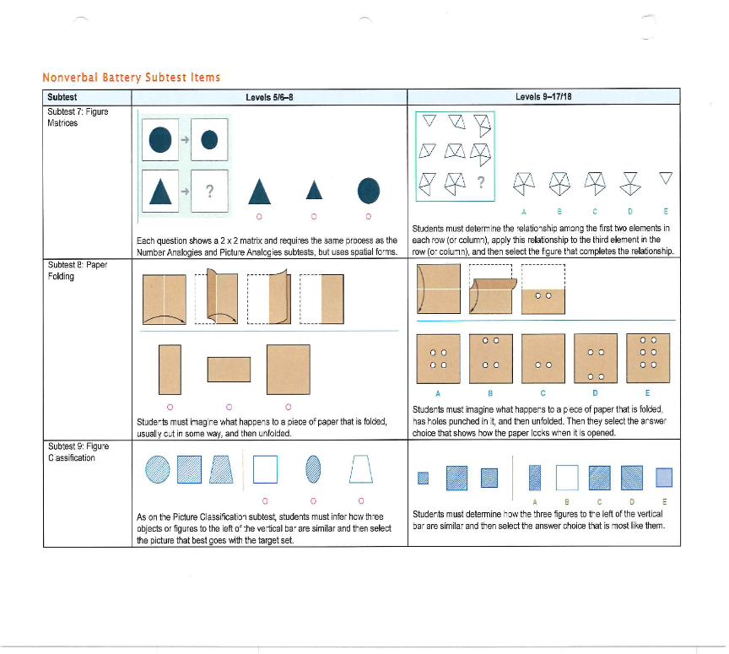
Non-verbal Sample
Notes:
Keeley

Slide 10
IOWA
Achievement Assessments
Notes:
Terri

Slide 11
IOWA Achievement Assessment
ELA Total
Reading
Written expression
Conventions of writing
Vocabulary
Math Total
Mathematics
Computation
Notes:
Terri

Slide 12
IOWA Overview
Made up of subtests covering content at the student’s grade level.
Reading
Math
Notes:
Terri

Slide 13
Math Acceleration
District Placement Assessment
Overview of Assessment
Notes:
Terri

Slide 14
Math Acceleration Assessment
District Placement Assessment
Multiple Choice
Untimed
Looking to see if mastered grade level content
Example: 3rd grader is tested on 4th grade Common Core Math Standards
Common Core Standards
http://www.corestandards.org/
Notes:
Terri

Slide 15
Iowa Algebra Aptitude Test
IAAT
Overview of Assessment
Notes:
Keeley

Slide 16
IAAT
Administered to current 5th grade Accelerated Math Students
Used in qualification for Project Arrow Math
Timed
60 items total
Four Subtests
Pre-algebraic Number Skills and Concepts
Interpreting Mathematical Information
Representing Relationships
Using symbols
Notes:
Keeley
Pre-Algebraic Number Skills and Concepts
The items on this subtest measure a student’s computational skills, understanding of mathematical concepts and the ability to solve mathematics problems.
Interpreting Mathematical Information
The items on this subtest are based upon information presented in graphs or upon definitions of mathematical terms or operations. The items assess how well a student can learn new material presented in graphs or text.
Representing Relationships
For each of the exercises in this part of the test, the student must find the rule that represents the given numerical relationship. Some of the items present the relationship in table form while others present the relationship in verbal form.
Using Symbols
The last subtest measures how well students understand some of the important symbols of algebra and how they are used.

Slide 17
Test Preparation
How do I prepare my child for the test?
“Students perform best on tests when they are rested and relaxed. Children test best that have had a stress-free evening the night before, have had a good breakfast, and plenty of rest, and are encouraged to show their best without worry or pressure. Children who enjoy learning puzzles and games (word games, crossword puzzles, chess, logic puzzles, etc) may find some of the test items similar.”
(Adapted from Riverside Publishing resources)
General test-taking tips are available at the websites included below:
http://www.scholastic.com/teachers/article/master-multiple-choice
http://pbskids.org/itsmylife/school/teststress/article10.html
https://www.teachervision.com/study-skills/teaching-methods/6390.html
Notes:
Keeley

Slide 18
Project Arrow Program
Overview and Qualification
Notes:
Siobhan

Slide 19
Elementary Project Arrow Overview
Academically Talented Instruction
Grades 3
200 minutes/week pull out instruction
Grades 4-5
300 minutes/week pull out instruction
Program designed to service:
“Children and youth with outstanding talent perform or show the potential for performing at remarkably high levels of accomplishment when compared with others of age, experience, or environment” (United States Office of Education, 1993).
Notes:
Siobhan

Slide 20
Elementary Project Arrow Overview Continued
Characteristics:
High intellectual capacity
Creative and/or artistic
Possess an unusual leadership capacity
Require services or activities not ordinarily provided in the regular education environment.
National Association of Gifted Children estimates a small percentage of the US K-12 population can be identified as academically gifted.
Notes:
Siobhan

Slide 21
Notes:
Siobhan

Slide 22
Elementary Project Arrow Qualification
Standardized Testing
Ability (CogAT) and Achievement Assessment (IOWA)
Typically above 95th percentile
Checklists of Characteristics
Classroom evidence provided by teacher
Notes:
Siobhan

Slide 23
Elementary PA Testing
PA Program for Grades 3-5th
Testing window: January 29-February 9
Recommended 2nd-4th grade students not currently in the PA program
If parent requests - student data will be reviewed to determine if further testing is warranted
Students take the IOWA Assessment
Achievement Assessment
Content
CogAT is used for PA qualification
Example: Current 4th grade student, who took the CogAT last year (3rd grade), has a valid CogAT score to be used for qualification this year.
Students who qualify will begin the program in 2018-19
Notes:
Siobhan

Slide 24
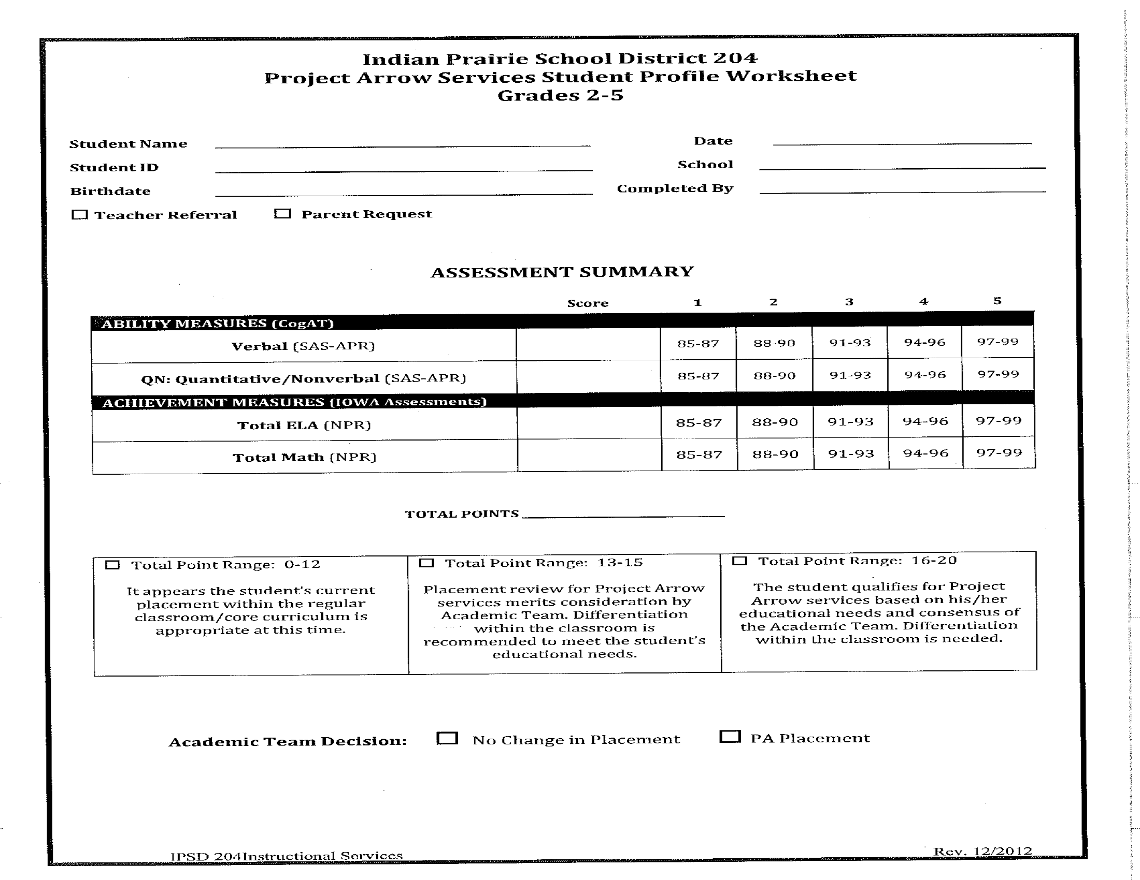
Elementary Project Arrow Student Profile Worksheet
Student’s current placement is the appropriate placement
Student qualifies for Project Arrow services.
Placement review is needed by Academic Team.
Notes:
Siobhan

Slide 25
Elementary Project Arrow Student Profile Worksheet
Example
Student example of CogAT showing no further testing needed.
Notes:
Siobhan

Slide 26
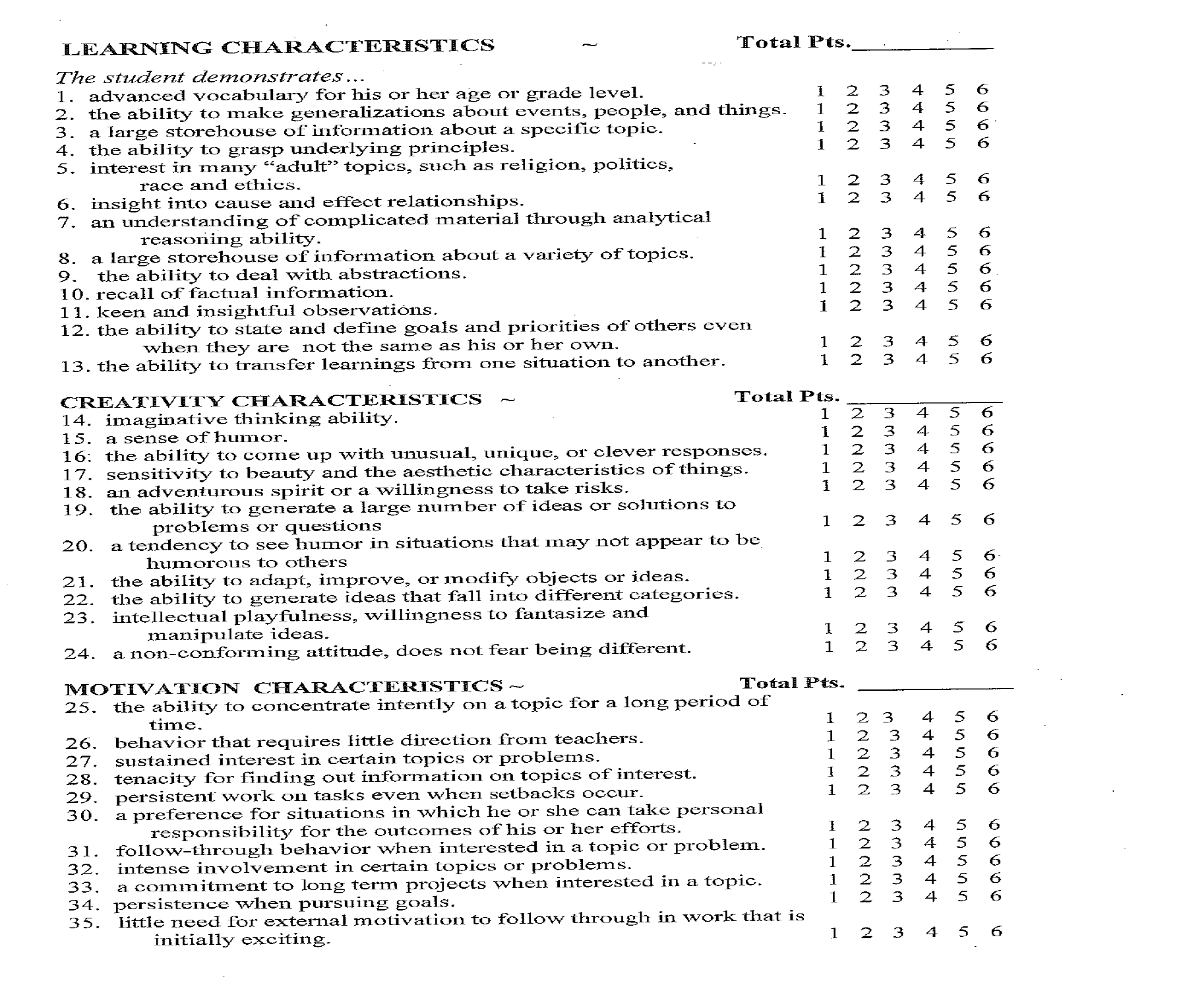
Scales for Rating Behavioral Characteristics of Superior Students (SRBCSS)
Notes:
Siobhan

Slide 27
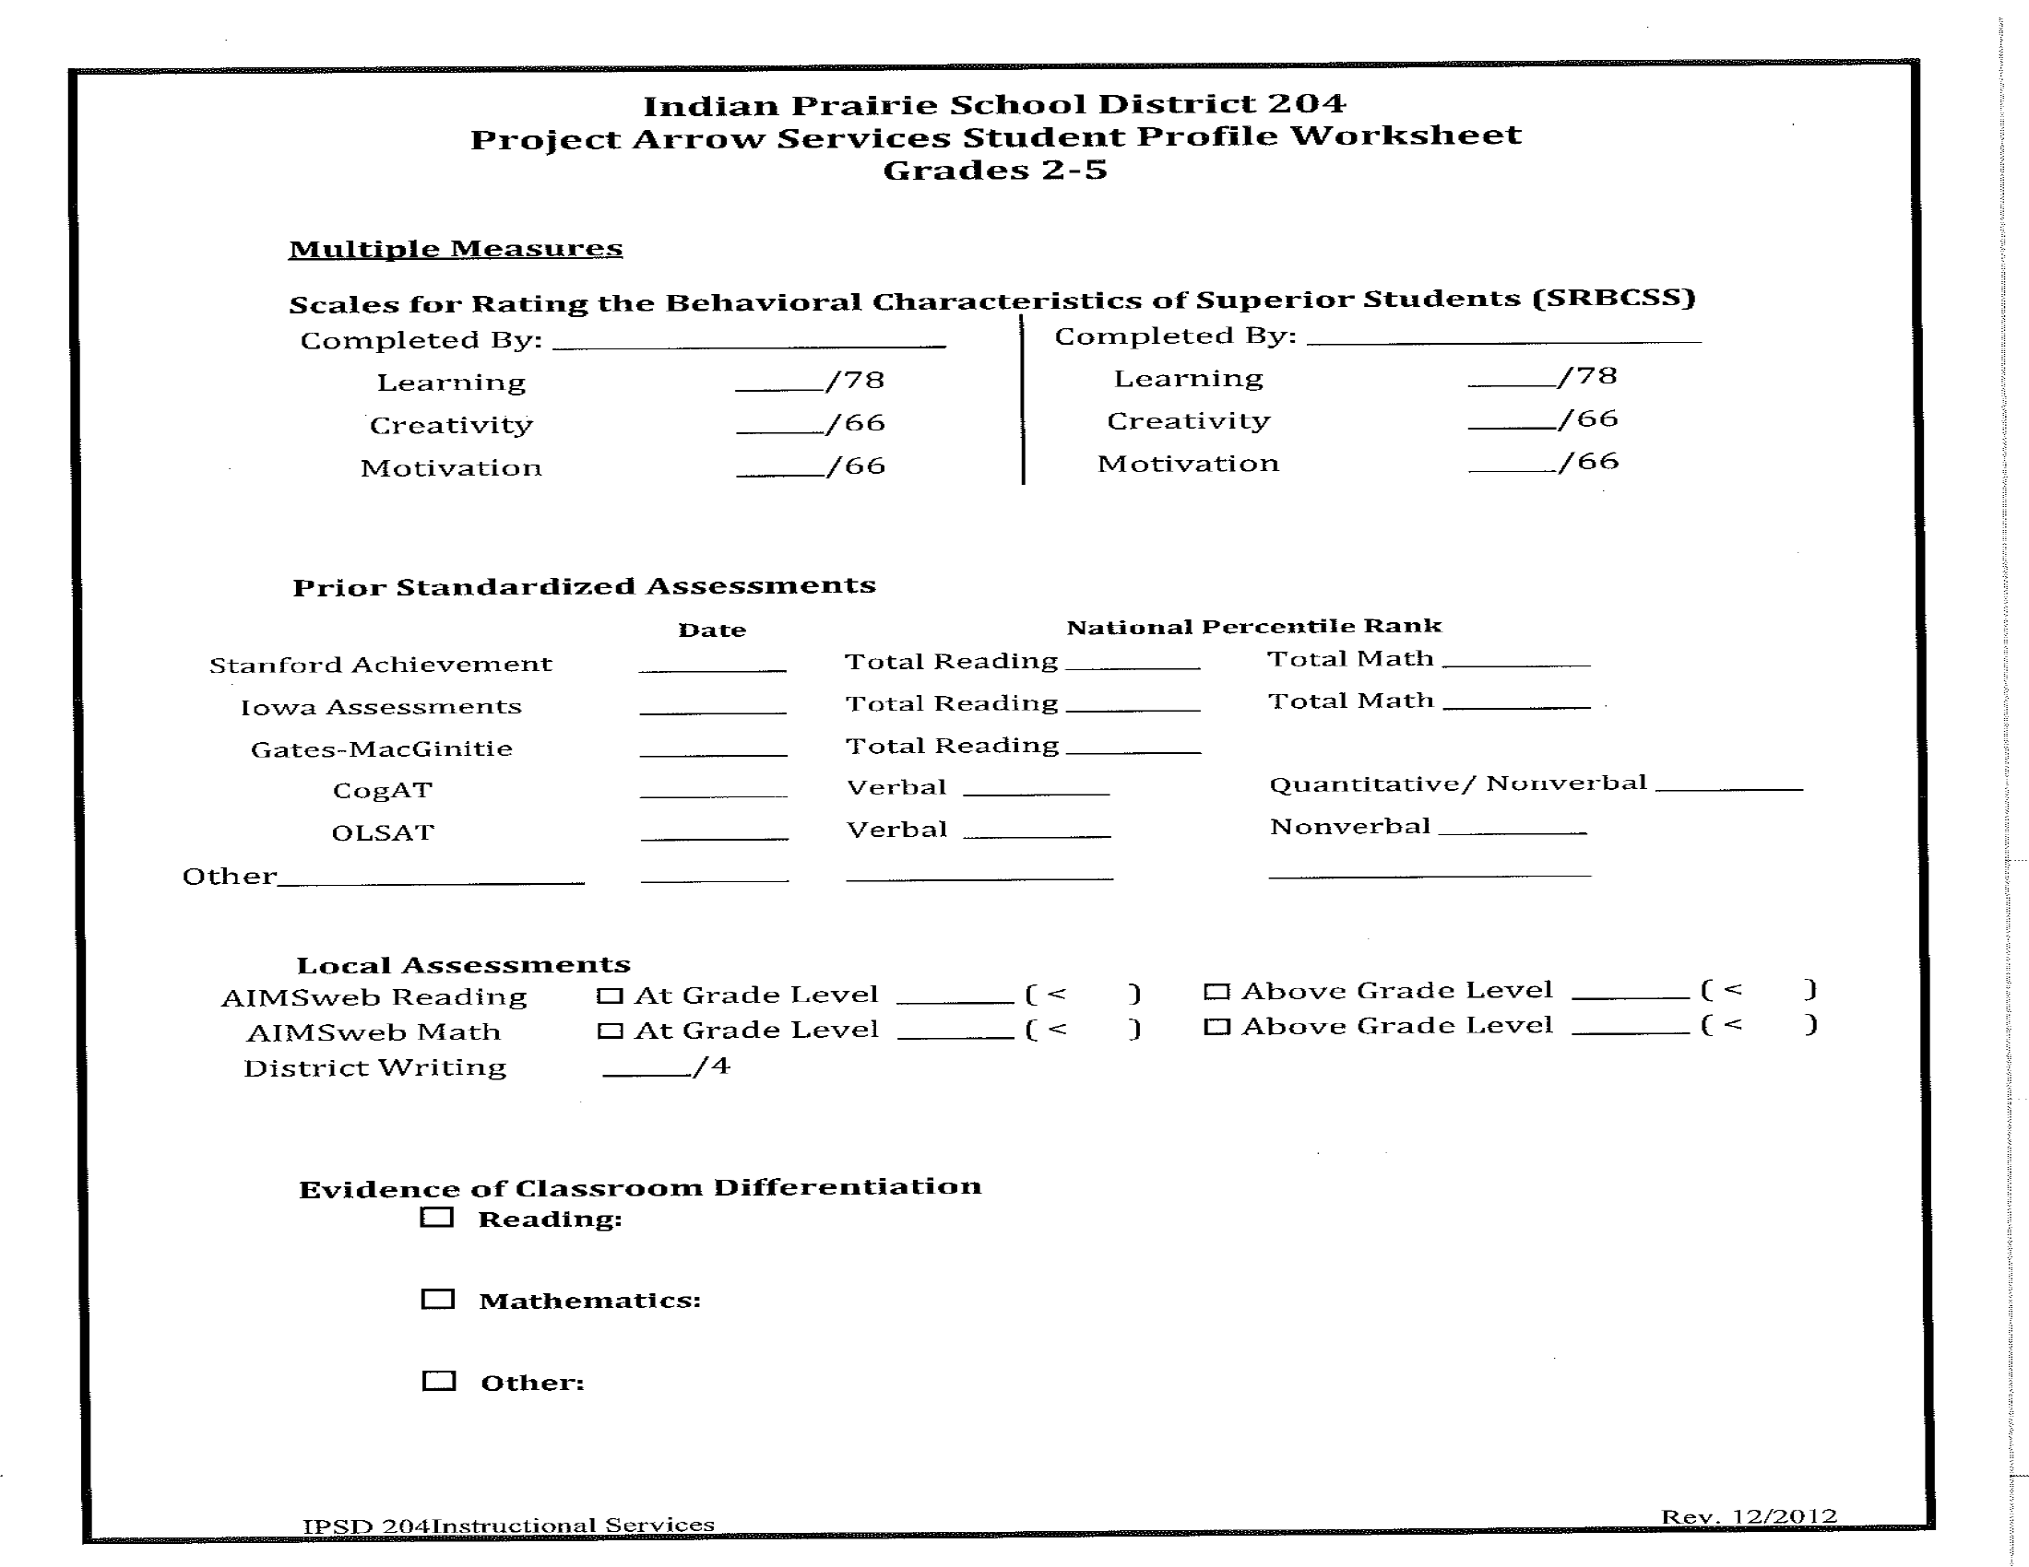
Notes:
Siobhan

Slide 28
Middle School Project Arrow
Notes:
Keeley

Slide 29
Middle School Project Arrow Overview
Accelerated/Enriched
Reading Strand
Literacy
Science
Social Studies
Math Strand
Pre-algebra (6th)
Algebra (7th)
Geometry (8th)
All current Elementary PA students must re-qualify for the program!
Notes:
Keeley

Slide 30
Middle School Project Arrow Reading Qualification
Standardized Testing
Ability (CogAT) and Achievement Assessment (IOWA)
Typically above 95th percentile
Checklists of characteristics/teacher input
Classroom evidence
All current PA students must re-qualify for the program!
Notes:
Keeley

Slide 31
Project Arrow Middle School Reading Student
Profile Worksheet
Notes:
Keeley

Slide 32
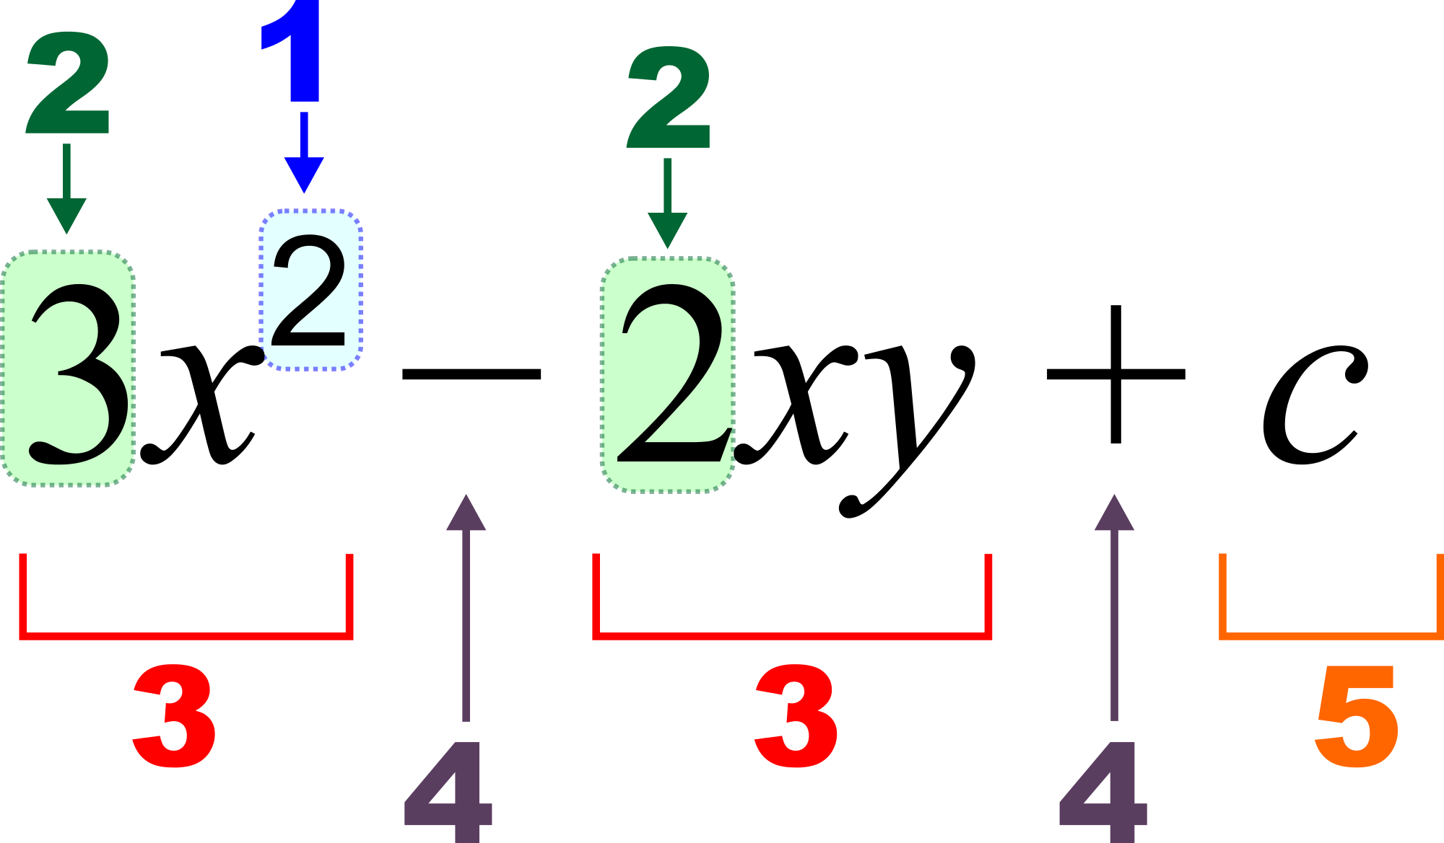
Middle School Project Arrow Math Qualification
Only eligible to test if already in Math Acceleration
Testing window: March 5-16 in Math Acceleration classrooms
Students Tested: *Current 5th grade MA students district-wide Test: IAAT (IOWA Algebra Aptitude Test) CogAT scores are also used for qualification
Note: if a student does not qualify for PA Math Strand, they remain in MA math (7th grade math)
Notes:
Keeley

Slide 33
Project Arrow Middle School Math Student
Profile Worksheet
Notes:
Keeley

Slide 34
Accelerated Math
Overview and Criteria
Notes:
Terri

Slide 35
Accelerated Math Overview
3rd-12th Grade students
Characteristics:
Strong mathematical problem solving and reasoning skills
Pick up skills at a quicker pace
3rd Grade
3rd/4th grade math curriculum
4th Grade
5th grade math curriculum
5th Grade
6th grade math curriculum
Notes:
Terri

Slide 36
Accelerated Math Qualifications
Standardized Testing
Ability Assessment (CogAT)
District Placement Test
March 5-16
Classroom evidence provided by teacher
Student can place via the CogAT OR the district placement assessment.
Ability vs. Achievement
Notes:
Terri

Slide 37
Online References
Informational letter with timelines sent out from Mrs. Russell:
https://goo.gl/PNT5bT
Link to webpage for Academically Talented Students
District 204 home page, for parents and staff
http://www.ipsd.org/Subpage.aspx/AT
Notes:
Terri

Slide 38
Questions?
Place your question on a index card and place it in the question box.
Notes:
Terri

Slide 39
THANK YOU!
We appreciate you coming to learn more about the programs for our Academically Talented Students!
Notes:
Terri

Slide 40
Academically Talented FAQ
Below, you will find the responses to questions asked at the end of the Academically Talented Parent Night. If you asked a question about the PA and Math Acceleration Program for students in grades K-2, please remember these programs start for our students in Grade 3.
What is the qualification process for 5th graders going to middle school? Please see slides # 28-33
How do we determine if new students are assessed for PA and MA? When students come from another district, a file review is completed. If there is evidence that testing has been done or that further testing is needed, we would complete it at that time.
How are parents notified of their child’s CogAt score and if the child qualifies for PA? Parents will receive copies of CogAt results (usually in December). Parents are notified of PA qualification in late April for entrance the following school year.
When is the IOWA assessment given? Please see the timeline previously sent:
https://docs.google.com/document/d/1J2ROKw8K5GpeoX8BV7x3mDxnG59WolUkvZ1RKDX-58o/edit
How is it determined if a child is assessed using the IOWA? If we do not have current achievement information on a child, and we believe we need additional information for qualification purposes, the IOWA would be administered. If we have cognitive information on the child, that would help us determine if further testing is warranted.

Slide 41
Academically Talented FAQ
Below, you will find the responses to questions asked at the end of the Academically Talented Parent Night. If you asked a question about the PA and Math Acceleration Program for students in grades K-2, please remember these programs start for our students in Grade 3.
6. Do students in PA automatically go into Honors and AP classes in high school? NO – students work with counselors to select their coursework in high school.
7. What is the total population we compare with when identifying for PA? CogAt and Iowa scores are national percentiles. We solely use the district criteria to determine qualification.
8. Do you consistently retests students who are doing well in class? We only retest students if we do not have the most current data needed for the qualification process.
9. Can the teacher provide a month assessment of how kids are doing. Teachers are formally and informally assessing students all the time. Report cards, progress reports, benchmarking data and routine school work sent home are all ways to view student progress. If you have additional questions as to how your child is doing, you are always welcome to contact the teacher.
10. What does “read the CogAt aloud” mean? Teachers read the directions and each question for the students in SECOND grade.
11. Will a student know when testing occurs? Students and Parents are notified of testing dates.
12. How do I prepare my child for PA testing? Please see slide #17

