Slide 1
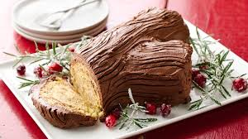
FRENCH CLUB
Thursday, December 7
Room 296 after school
We willing be decorating
our Bûches de Noël.

