Slide 1
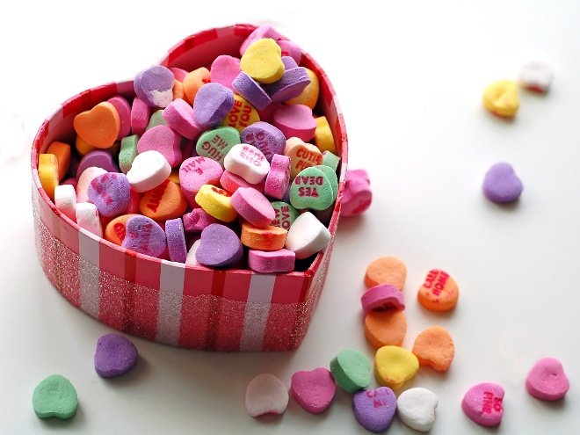
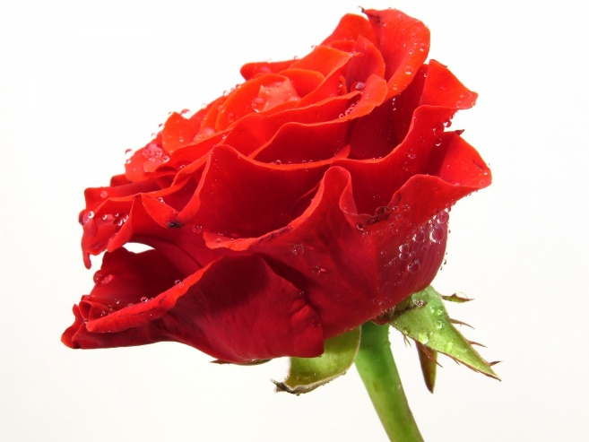
Valentine’s Day Grams
Purchase grams from BSA
Feb 9th, 12th and 13th during all lunches in the cafeteria.
All grams will be delivered on Wed, Feb 14th during all lunch periods
Roses and candy grams will be available
Rose Grams - $3.00
Candy grams from $.50 - $3.00
All grams come with a card!

